Slide 1


Lecture1: introduction to reinforcement learning
Dr. MALKI Abdelhamid @: a.malki@esi-sba.dz
Ecole Supérieure d’Informatique de Sidi Bel Abbes (ESI-SBA) 2024/2025
Module IASD: Advanced Deep Learning (ADL)

Slide 2
Objectives
Learn the principles of Reinforcement Learning (RL) and Deep RL techniques ranging from Deep Q-Networks (DQN) to Deep Deterministic Policy Gradients (DDPG).
Apply DRL techniques to train agents to walk, drive, or do other complicated tasks
Learn how to use DRL methods in applications with many, interacting agents.
Develop DRL models for interactive agents to demonstrate collaboration or cooperation on a complex task

Slide 3
Prerequisites
Machine Learning
Deep Learning

Slide 4
Organization & evaluation
Hourly Volume
15 weeks *2h : (course + Lab)
Evaluation
Exam : 30%
Lab: 70%
Credits: 5
Coefficient: 4

Slide 5
Course Content
Foundations for DRL (2h) :
Introduction to Reinforcement Learning ,
Reinforcement Learning terminology
Markov Decision Processes
Kinds of RL algorithms
Value-Based Methods (8h)
Bellman Equation
Monte-Carlo, Temporal-Difference
Q-Learning /SARSA
Deep Q-Network (DQN) & Double DQN (DDQN)
Dueling Deep Q-Learning & Prioritized Experience Replay.

Slide 6
Course Content
Policy-Based Methods (10h)
Stochastic policy search
Policy gradient & REINFORCE Algorithm
Actor-critic methods (A2C, A3C, …)
Advanced policy gradient methods (PPO, TRPO, DDPG, …)
Advanced Topics In Reinforcement Learning (10h)
Multi-Agents Reinforcement Learning
Model-Based Reinforcement Learning
Reinforcement learning from human feedback
Offline Reinforcement Learning
Hierarchical & Inverse Reinforcement Learning
Meta-Learning & Transfer learning

Slide 7
Bibliography
Lapan, M. (2020). Deep reinforcement learning hands-on. Packt publishing.
Palanisamy, P. (2018). Hands-On Intelligent Agents with OpenAI Gym: Your guide to developing AI agents using deep reinforcement learning. Packt Publishing Ltd.
Morales, M. (2020). Grokking deep reinforcement learning. Manning Publications.

Slide 8
What is Reinforcement Learning?
What is it? An Agent that will learn from an Environment to solve sequential decision making problems.
How? Interacting with the Environment through trial and error and receiving rewards (negative or positive) as feedback for performing the future Actions.

Slide 9

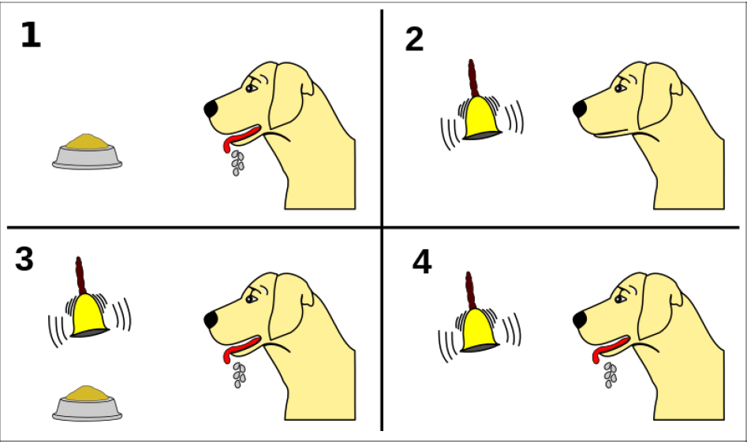

What is Reinforcement Learning?
Learning from interactions with the environment comes from our natural experiences before artificial intelligence had started.

Slide 10
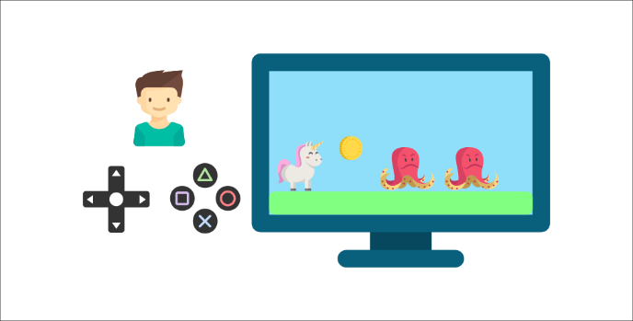
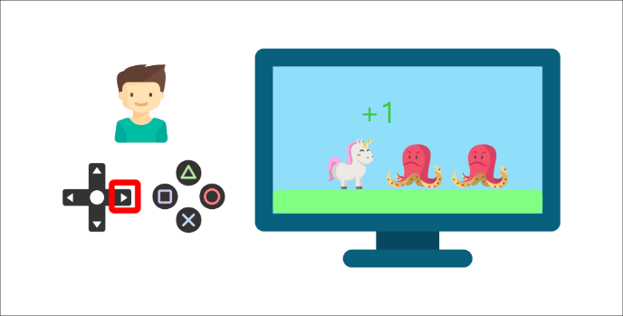

What is Reinforcement Learning?
Imagine putting a child in front of a video game he never played.
He will interact with the game (environment) by pressing the right button (action).
➔ He got a coin, that’s a +1 reward.
But then, he presses the right button again and he touches an enemy.
➔ He just died, so that’s a -1 reward.
By interacting with his environment through trial and error, he understands that he needs to get coins but avoid the enemies.

Slide 11
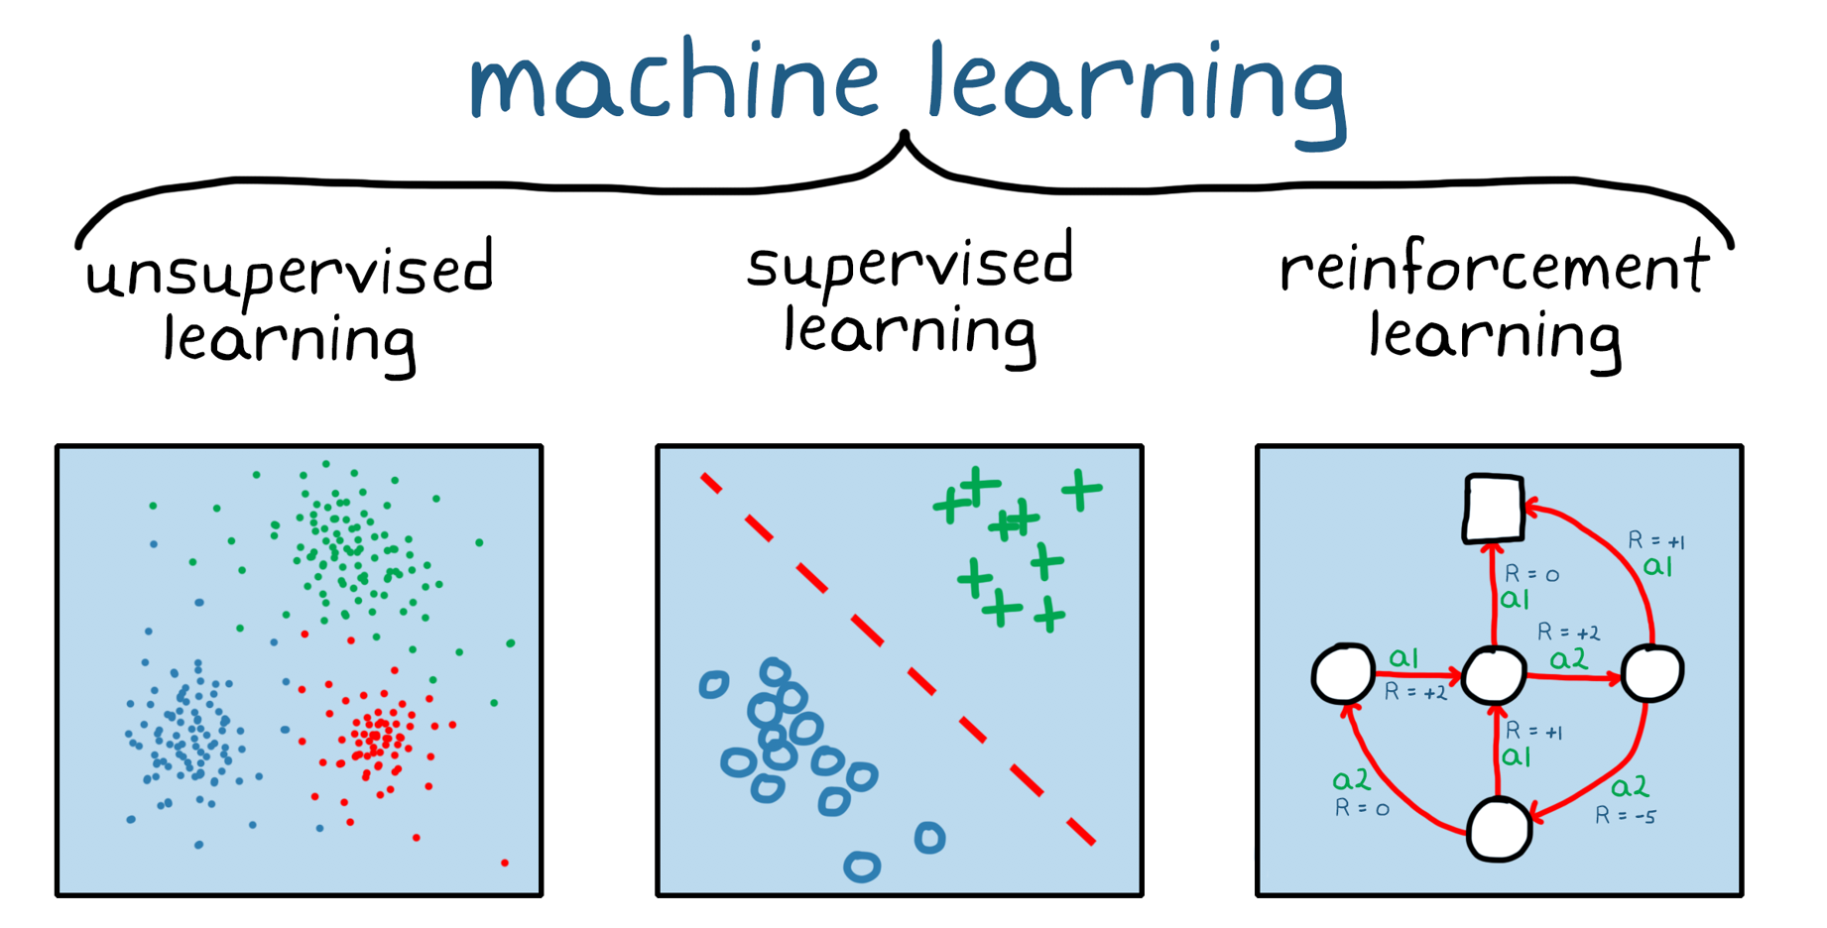
Types of learning
https://www.mathworks.com/discovery/reinforcement-learning.html
Supervised/unsupervised Learning is “teach by example
Here’s some examples, now learn patterns in these examples.
Reinforcement learning is “teach by experience
Here’s a world, now learn patterns by exploring it.

Slide 12
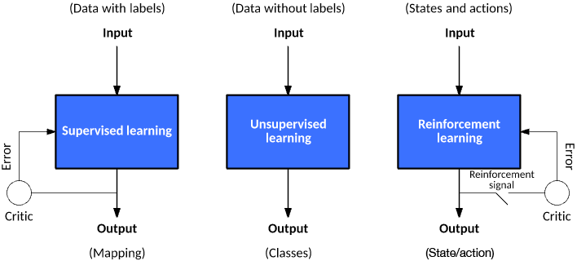
Types of learning

Slide 13
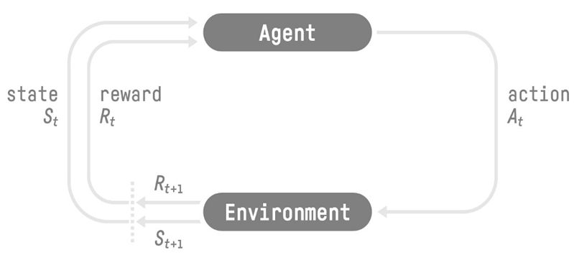
Reinforcement Learning terminology
The RL Process: a loop of state, action, reward and next state
At each step, the agent:
Select the best action
Executes action
Observe new state
Receive reward

Slide 14
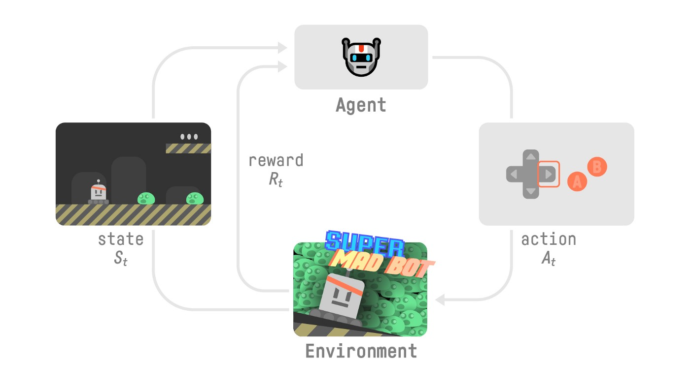
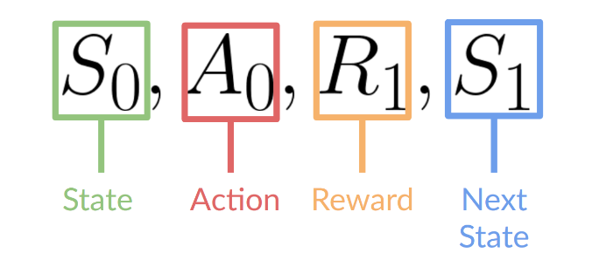
Reinforcement Learning terminology
Our Agent receives state S0​ from the Environment
we receive the first frame of our game (Environment).
Based on that state S0​, the Agent takes action A0​
our Agent will move to the right.
The environment goes to a new state S1​
new frame.
The environment gives some reward R1​ to the Agent
we’re not dead (Positive Reward +1).

Slide 15
Goal of RL: Maximize Reward
What action to take in a state?
Find the optimal policy π* that select for each state the action that maximizes the expected cumulative future reward
Because RL is based on the reward hypothesis, which is that all goals can be described as the maximization of the expected cumulative reward.
That’s why in Reinforcement Learning, to have the best behavior, we aim to learn to take actions that maximize the expected cumulative reward.

Slide 16
Markov Decision Process
Markov decision processes (MDPs) are a useful mathematical framework to formalism any sequential decision making problem (RL)
An MDP(S, A, T_{a}, R_{a}, 𝛾 ) is defined by:
Set of states S, as a set of all possible states.
Set of actions A, as a set of all possible actions.
Transition function T_{a}(s’ | s, a), as a state transition probabilities.
Reward function R(s, a, s’), as rewarding mapping from state s, action a, next state s’ tuple to reward.
Discount factor 𝛾, ∈ [0,1], a real number determining the importance of future rewards for control objective.

Slide 17


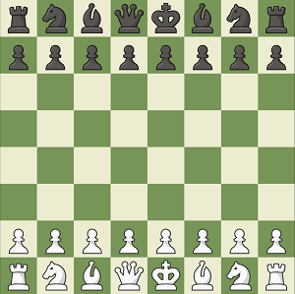
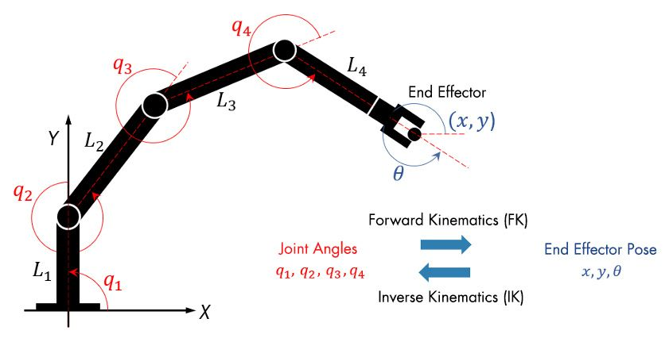
States Space
State is the information our agent gets from the environment at a timestep t.
Video game➔ a frame (a screenshot).
Chess game ➔ pieces on a board
Trading agent ➔ value of a certain stock.
Robotic Arm ➔ angles of joints

Slide 18
States Space
State vs Observation:
State s: is a complete description of the state of the world (there is no hidden information).
Observation o: is a partial description of the state. In a partially observed environment.

Slide 19
Action Space
The Action space is the set of all possible actions in an environment.
state s_{t} → action a_{i} → state s_{t+1}
The actions can come from a discrete or continuous space:
Discrete space: the number of possible actions is finite.
In Super Mario Bros, we have a finite set of actions : 4 directions and jump.
Continuous space: the number of possible actions is infinite.
A Self Driving Car agent has an infinite number of possible actions since it can turn left 20°, 21,1°, 21,2°, honk, turn right 20°…
The action space type is important when choosing the RL algorithm.

Slide 20
transition
The transition function T_{a}(s’ | s, a), determines how the state s changes to the next state s’ after the action a has been selected.
In model-free reinforcement learning the transition function is implicit to the solution algorithm: the environment has access to the transition function, and uses it to compute the next state s’, but the agent has not.
T_{a}(s’ | s, a) ➔ state s→ action a → state s’
the s->a part is chosen by the agent (policy)
the a->s’ part is chosen by the environment
In model-based reinforcement learning, the agent has its own transition function, an approximation of the environment’s transition function, which is learned from the environment feedback.

Slide 21
Episode/Trajectory
Trajectory/Episode/Rollout is the sequence of <state,action,reward> from start to finish
we denote the trajectory as τ = {<s_{t}, a_{t}, r_{t}>, <s_{t+1}, a_{t+1}, r_{t+1}>, ...}
Episodic problems have an end
Each round of a game is an episode
Continuous problems continue for ever
A robot that continuously manages manufacturing or warehouse automation

Slide 22
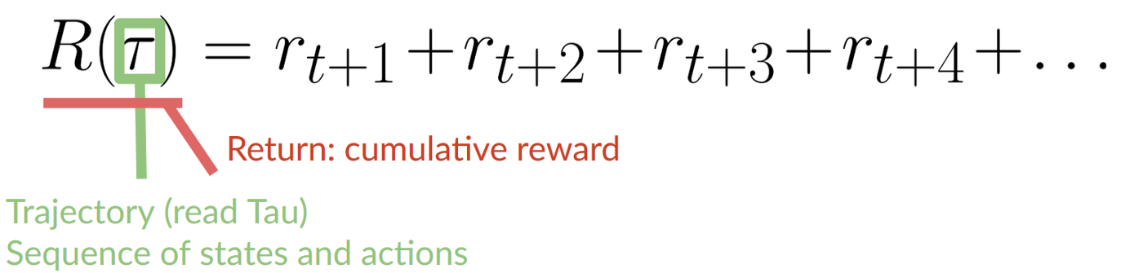
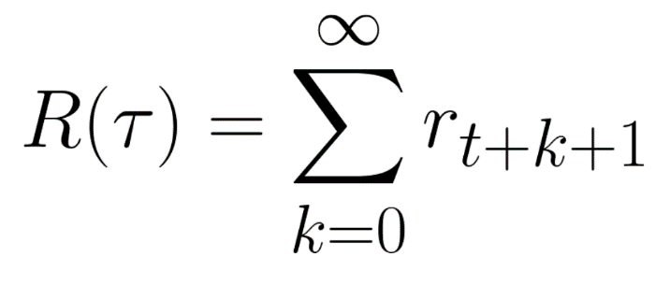
Rewards
R_{a}(s,s’) is the Reward received after action a transitions from state s to state s’
The reward is fundamental in RL because it’s the only feedback for the agent to choose the best actions.
The cumulative reward (Return) can be written as the sum of all rewards in the Trajectory/Episode sequence.
Which is equivalent to:

Slide 23
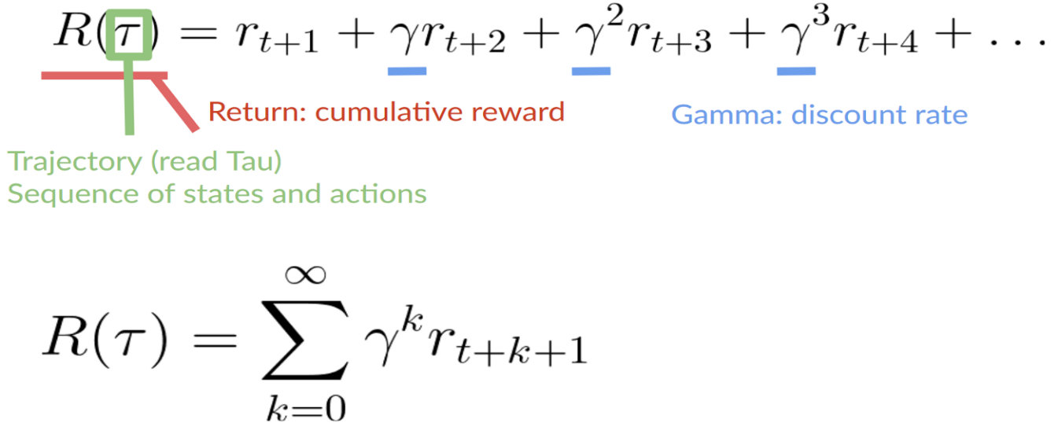
Discount factor
Gamma (𝛾) is the discount factor, discounting the importance of future rewards
It must be between 0 and 1. Most of the time between 0.95 and 0.99.
The larger the gamma, the smaller the discount. This means our agent cares more about the long-term reward.
The smaller the gamma, the bigger the discount. This means our agent cares more about the short term reward (Immediate Reward).
Sometimes ignored (𝛾 =1) in episodic problems.

Slide 24
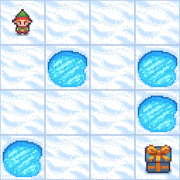
Examples of RL problems
Frozen Lake
Goal: cross a frozen lake from start to goal without falling into any holes.
State: The player’s current position as current_row * nrows + current_col
Actions: direction to move the player: left, right, down, up
Reward: reach goal: +1, reach hole: 0, reach frozen: 0

Slide 25
Examples of RL problems
Cart-Pole Balancing
Goal: Balance the pole on top of a moving cart
State: Pole angle, angular speed, cart position, horizontal velocity.
Actions: horizontal force to the cart
Reward: 1 at each time step if the pole is upright

Slide 26
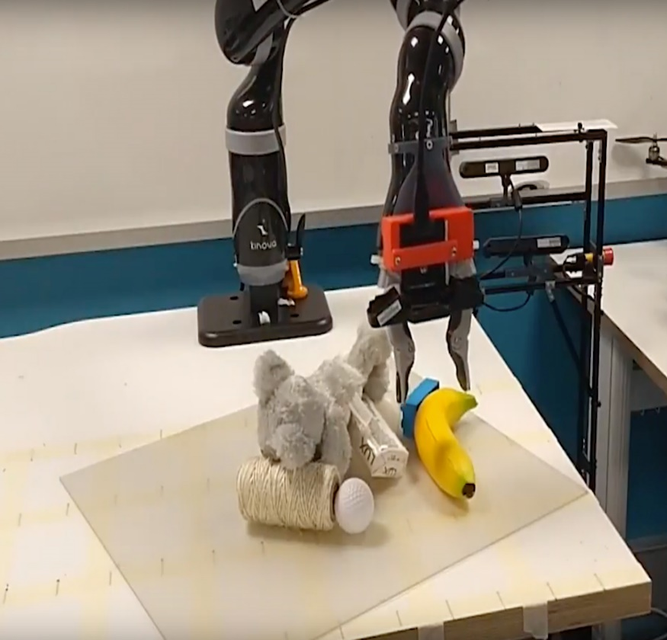
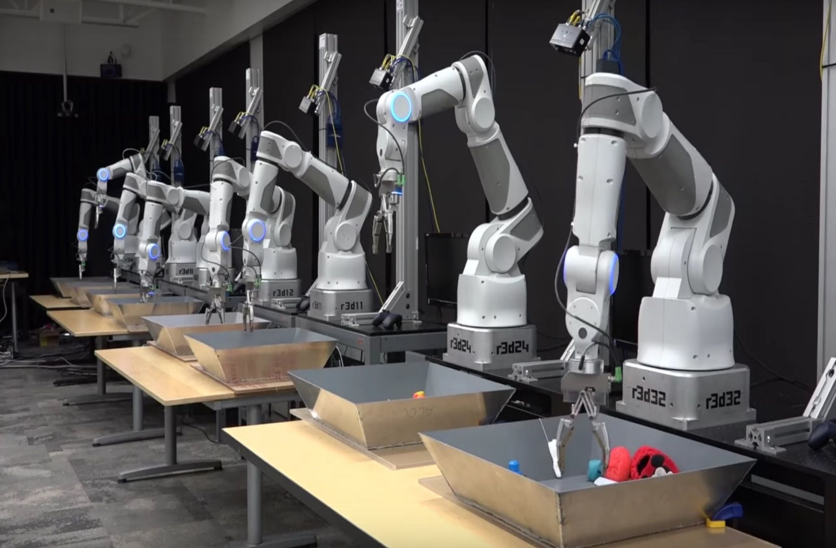
Examples of RL problems
Grasping Objects with Robotic Arm
Goal: Pick an object of different shapes
State: Raw pixels from camera.
Actions: Move arm (Control x, y, z movement) + Grasp.
Reward: Positive when pickup is successful

Slide 27
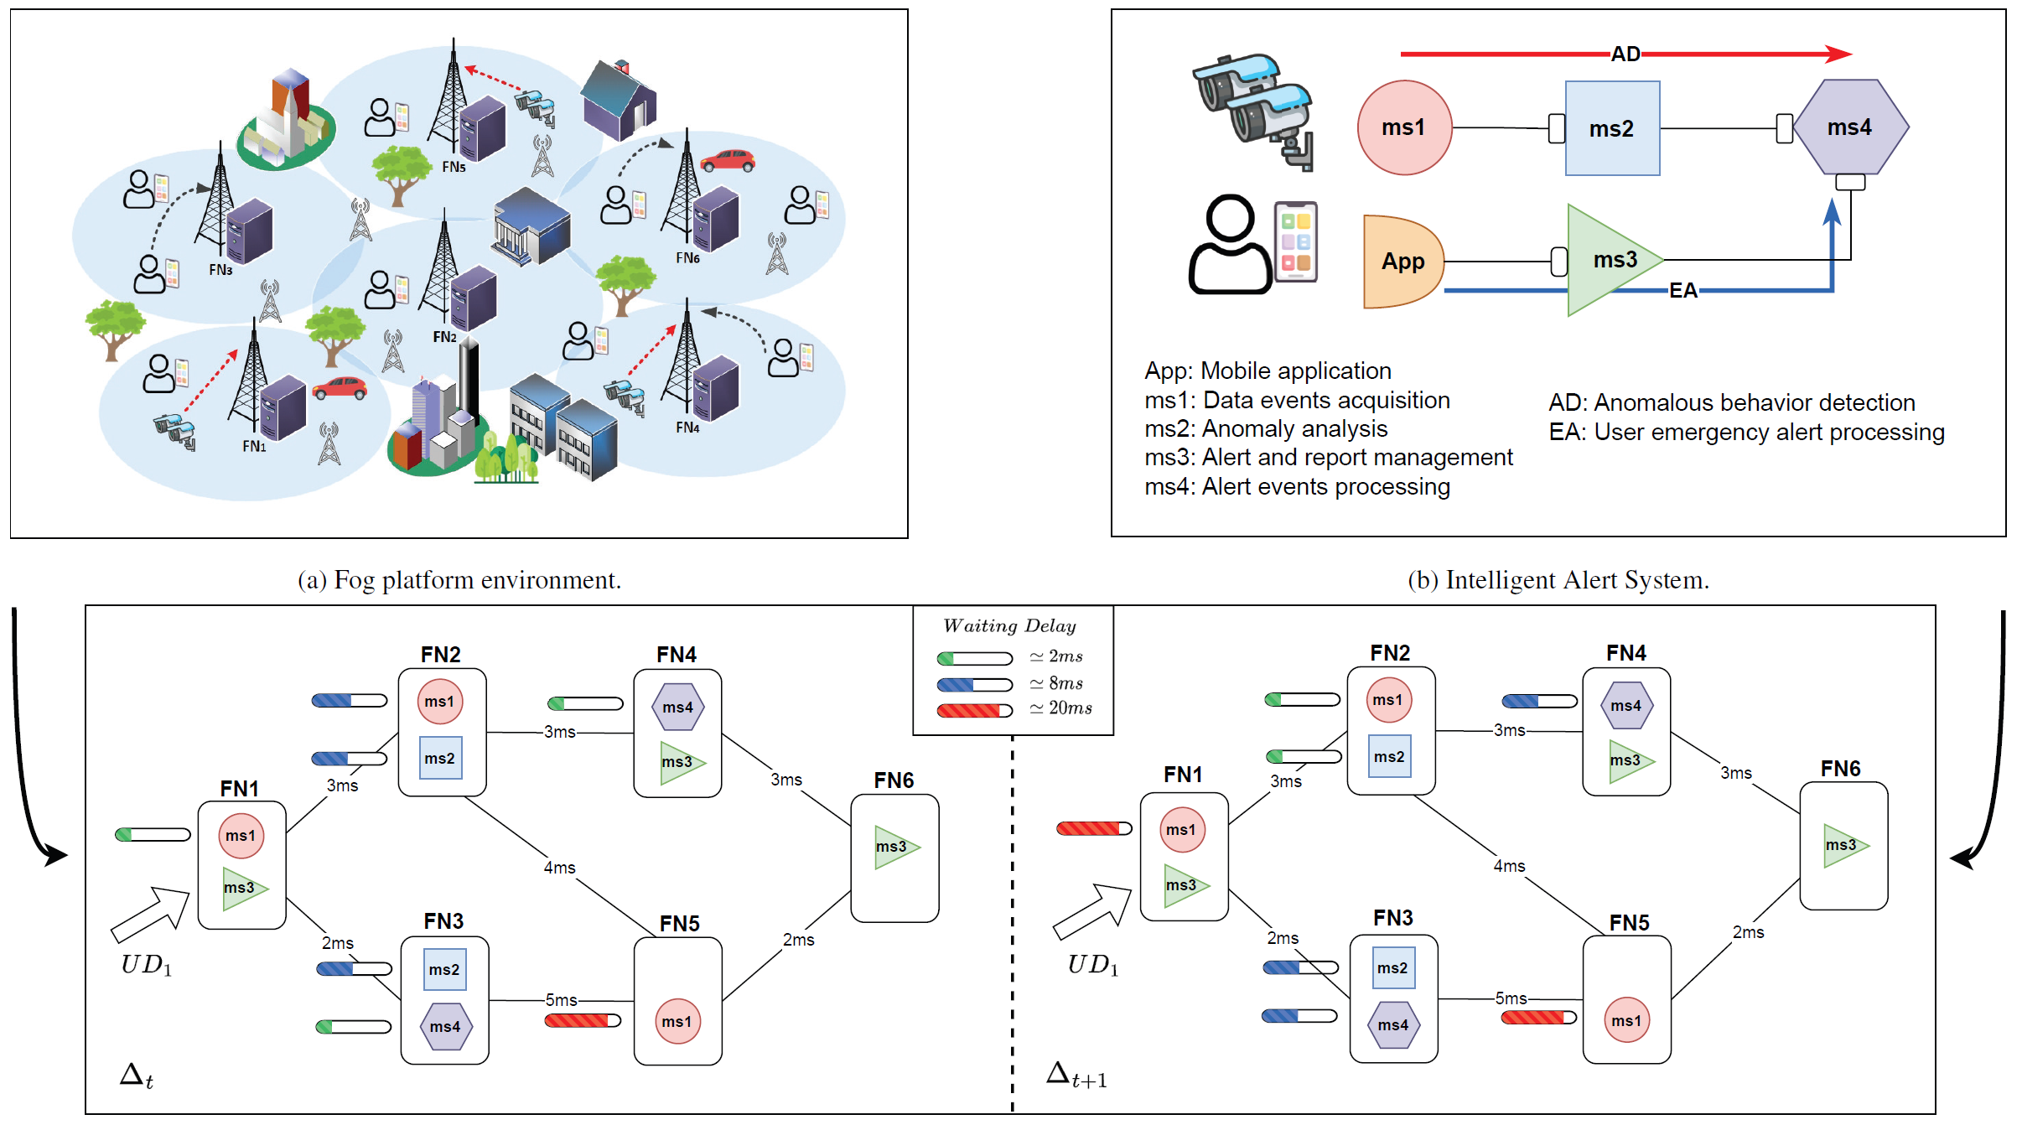
Examples of RL problems
Microservice Instances Selection and Load Balancing in Fog Computing
Goal: Ensuring a trade-off between service delay and load balancing
State: load of microservice instances, IoT Request, Fog Node state, etc
Actions: The best Physical execution plan.
Reward: Deadline violation and the load imbalance degree

Slide 28
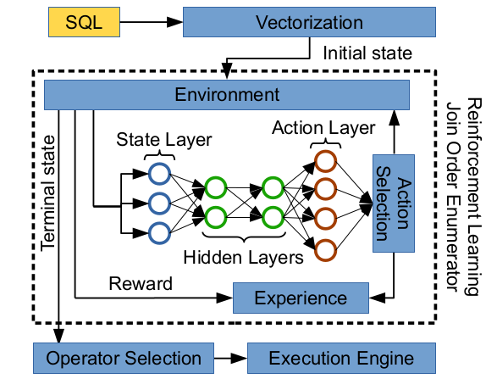
Examples of RL problems
Join Query Optimization using Deep Reinforcement Learning
Goal: Generating the best Query Execution Plan (i.e., the best join order)
State: Query, the current Join Query Plan, join Selectivity, etc
Actions: The best next Join Order.
Reward: Estimated Cost or real Execution Cost or real Execution Time

Slide 29
Examples of RL problems
Other reinforcement learning problems:
Fly a helicopter ➔ Reward: air time, inverse distance, ...
Make a robot walk ➔ Reward: distance, speed, ...
Manage an investment portfolio ➔ Reward: gains, gains minus risk, ...
Control a power station ➔ Reward: efficiency, ...
Play video or board games ➔ Reward: win, maximize score, ...

Slide 30
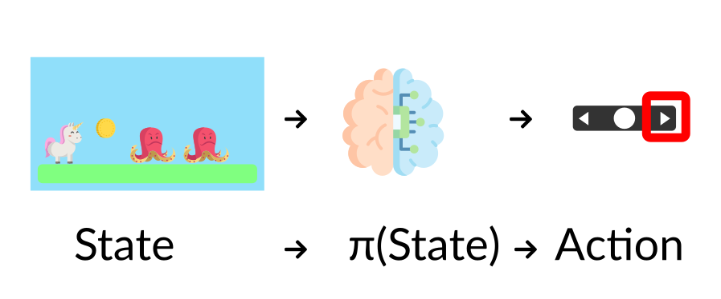
Kinds of RL algorithms
The Policy π: the agent’s brain
The Policy π is the brain of our Agent, it’s the function that tells us what action to take given the state we are in. So it defines the agent’s behavior at a given time.
This Policy is the function we want to learn, our goal is to find the optimal policy π*, the policy that maximizes expected return when the agent acts according to it.

Slide 31
Kinds of RL algorithms
There are two approaches to train our agent to find this optimal policy π* (model-free):
Indirectly, by teaching the agent to learn which state is more valuable and then take the action that leads to the more valuable states: Value-Based Methods.
Directly, by teaching the agent to learn which action to take, given the current state: Policy-Based Methods.

Slide 32
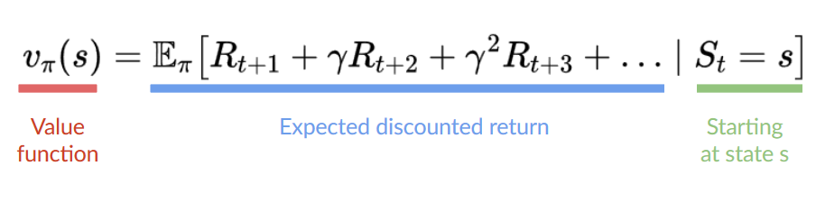
Kinds of RL algorithms
Value-based methods:
In value-based methods, instead of learning a policy function, we learn a value function that maps a state to the expected value of being at that state.
The value of a state is the expected discounted return the agent can get if it starts in that state, and then acts according to our policy.
“Act according to our policy” just means that our policy is “going to the state with the highest value”.

Slide 33
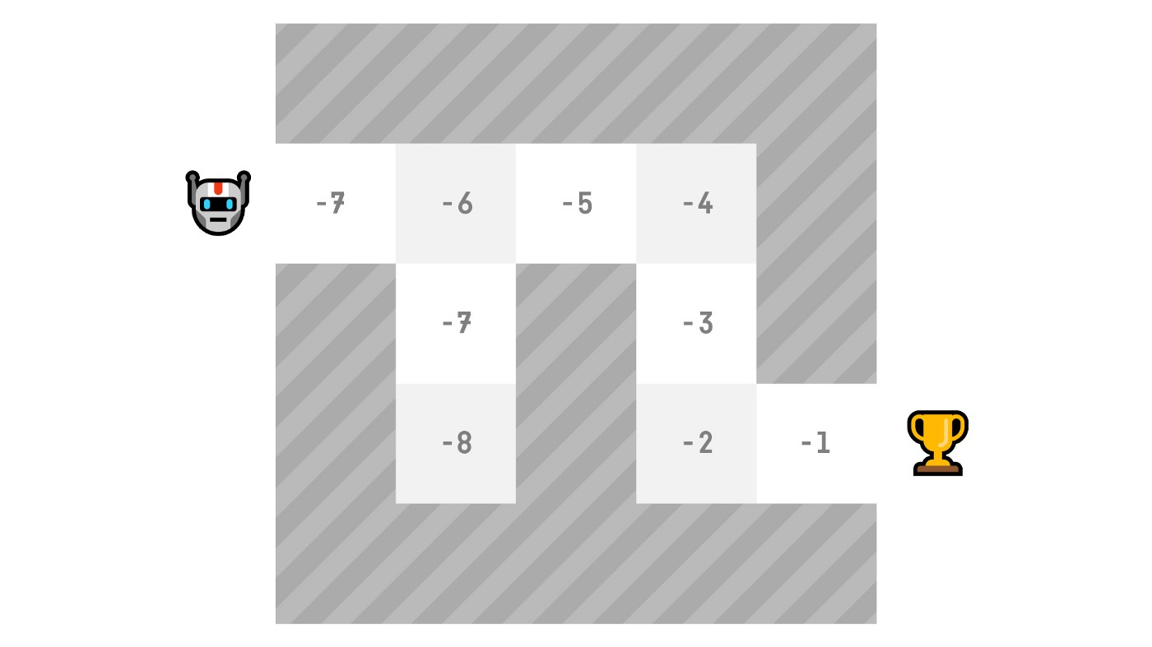
Kinds of RL algorithms
Value-based methods:
Here we see that our value function defined values for each possible state.
At each step our policy will select the state with the biggest value defined by the value function: -7, then -6, then -5 (and so on) to attain the goal.

Slide 34
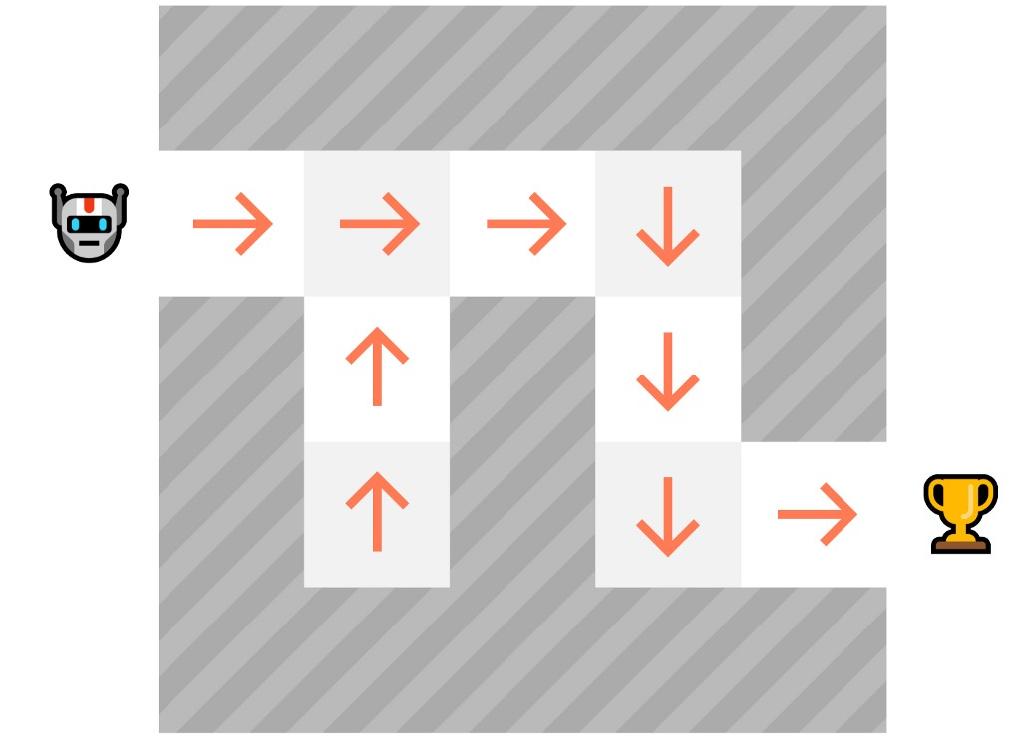
Kinds of RL algorithms
Policy-Based Methods (Policy Optimization):
In Policy-Based methods, we learn a policy function directly.
This function will define a mapping from each state to the best corresponding action. Alternatively, it could define a probability distribution over the set of possible actions at that state.
We have two types of policies:
Deterministic
Stochastic

Slide 35
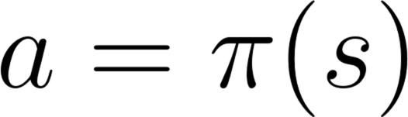
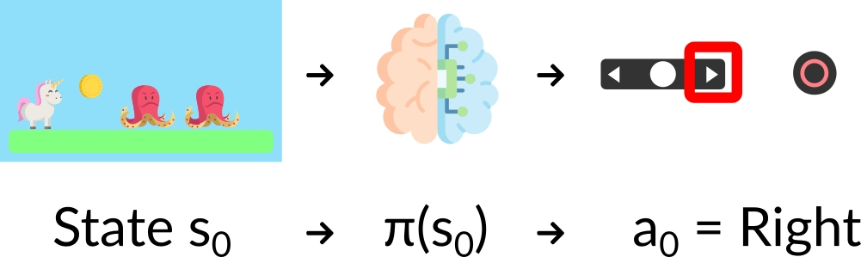
Kinds of RL algorithms
Policy-Based Methods
Deterministic: a policy at a given state will always return the same action.
action = policy(state)

Slide 36
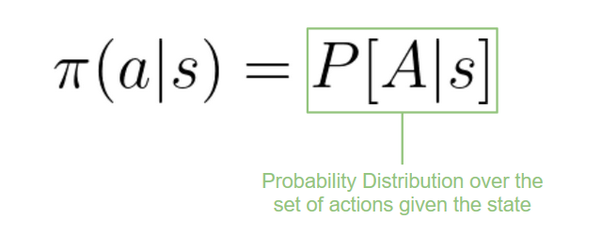
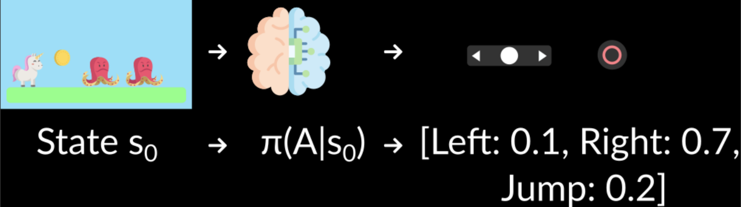
Kinds of RL algorithms
Policy-Based Methods
Stochastic: outputs a probability distribution over actions.
policy(actions|state) = probability distribution over
the set of actions given the
current state

Slide 37
Kinds of RL algorithms
Value-based algo:
SARSA,
Tabular Q-Learning,
DQN, DDQN, etc
Policy-Based algo:
Policy Gradient (REINFORCE)
A2C/A3C
PPO,
TRPO
Hybrid (Interpolating Between Policy-Based and Value-Based):
DDPG,
SAC

Slide 38
RL frameworks
Stable Baselines: is a set of improved implementations of Reinforcement Learning (RL) algorithms based on OpenAI Baselines.
KerasRL: It implements some state-of-the-art RL algorithms, and seamlessly integrates with Deep Learning library Keras.
CleanRL: a Deep Reinforcement Learning library that provides high-quality single-file implementation with research-friendly features
Tensorforce: Tensorforce is an open-source Deep RL library built on Google’s Tensorflow framework.
Pyqlearning: It focuses on Q-Learning and multi-agent Deep Q-Network.
ML-Agent, TF-Agents, ReAgent

Slide 39
REF
https://huggingface.co/learn/deep-rl-course/
https://deep-reinforcement-learning.net/
Slides for the course Reinforcement Learning (Master Computer Science 2022 at Leiden University)

